Slide 1
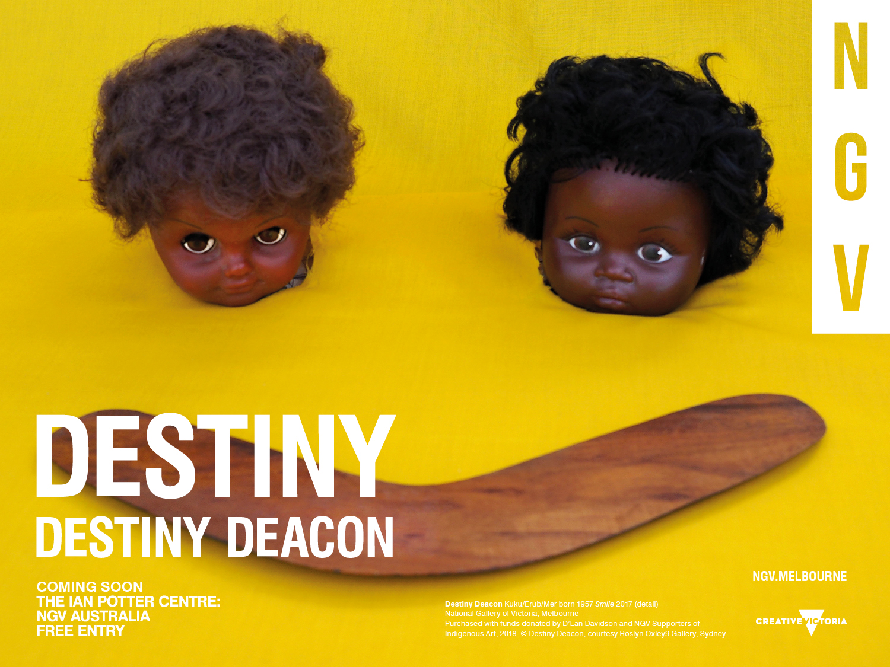
Notes:
Introduction to DESTINY
Destiny Deacon is one of Australia’s boldest and most acclaimed contemporary artists. In the largest retrospective of her work to date, DESTINY marks the artist’s first solo show in over 15 years. Featuring more than 100 multi-disciplinary works made over a 30-year period, the exhibition includes the premiere of newly-commissioned works.
Learning objectives
Analyse and interpret themes, concepts and ideas in Destiny Deacon’s work and discuss how they are expressed.
Discuss how Destiny Deacon uses materials, techniques, technologies and processes to realise the intentions in her artworks.
Discuss important influences on Destiny Deacon’s style and art making.
Identify and connect specific aspects of Deacon’s work to a wider historical, cultural and social context.
Discussion prompt
In small groups create a list of words to describe Smile, 2017, including adjectives and nouns. What might these words suggest about Deacon’s art and practice?

Slide 2
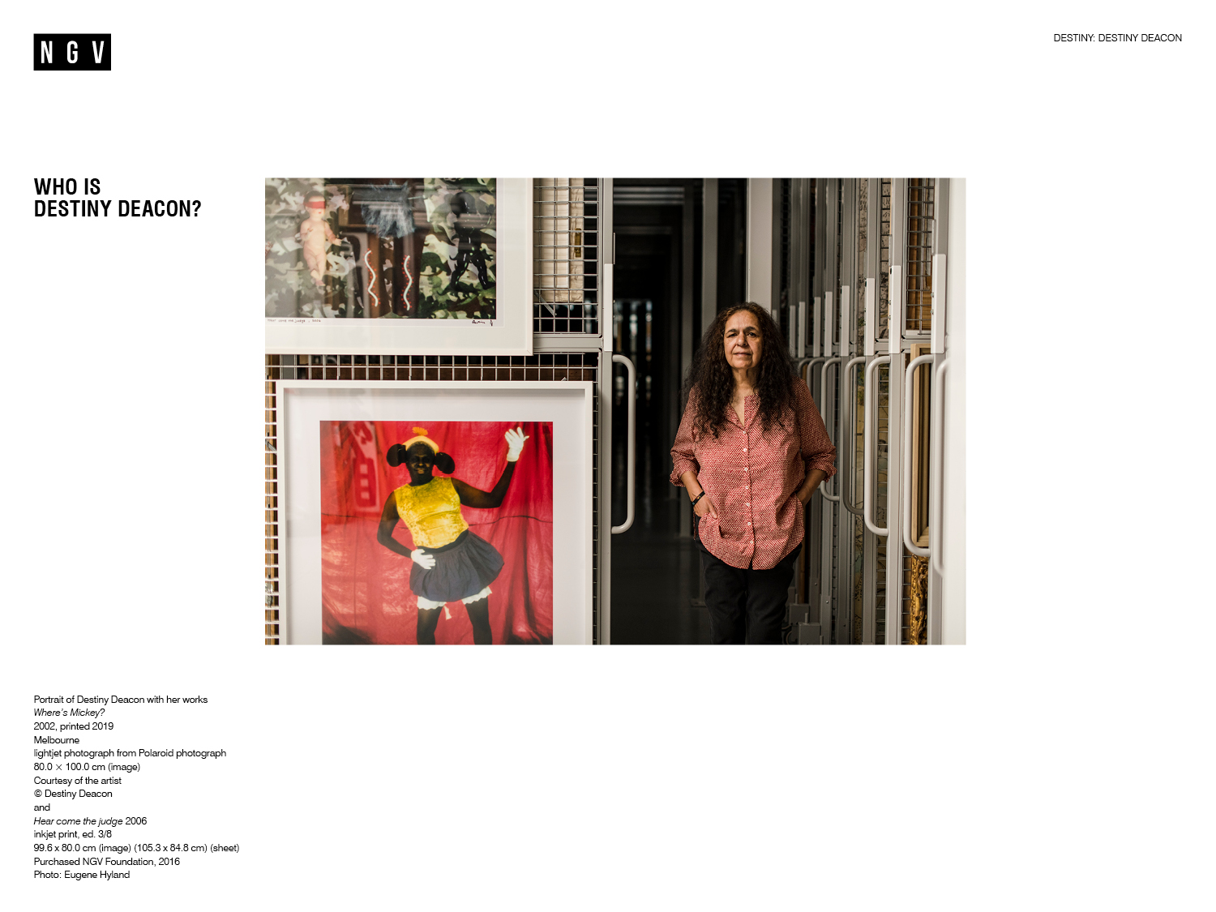
Notes:
Who is Destiny Deacon?
Destiny Deacon (b. 1957) is a self-taught artist who is descended from the KuKu and Erub/Mer peoples of far north Queensland and the Torres Strait. Throughout her life she has also been a respected political activist, broadcaster, writer and performer. She studied politics and education at University, and has worked across Victoria as a history teacher, a tutor and lecturer in Australian writing and culture, and as an Aboriginal and Torres Strait Islander cultural production teacher at the University of Melbourne.
In the early 1980s, Deacon worked for famous Aboriginal activist Charles Perkins AO, the first Aboriginal secretary of the federal Department of Aboriginal Affairs. Deacon has a long history of working in and for Community, and has participated in many protests including those held at the Aboriginal Tent Embassy in Canberra in 1972.
In the late 1980s, Deacon began her career as an artist. She started by filming video on an Open Channel VHS video camera and moved on into photography in 1990. Teeming with social, political, cultural and pop-cultural references, her work features her collection of dolls and kitsch objects which she calls ‘Koori Kitsch’. Deacon also is known for photographing friends and family with a distinctly humorous twist.
Read more about Destiny Deacon’s biography here: https://www.latrobe.edu.au/alumni/profile/Destiny-Deacon

Slide 3
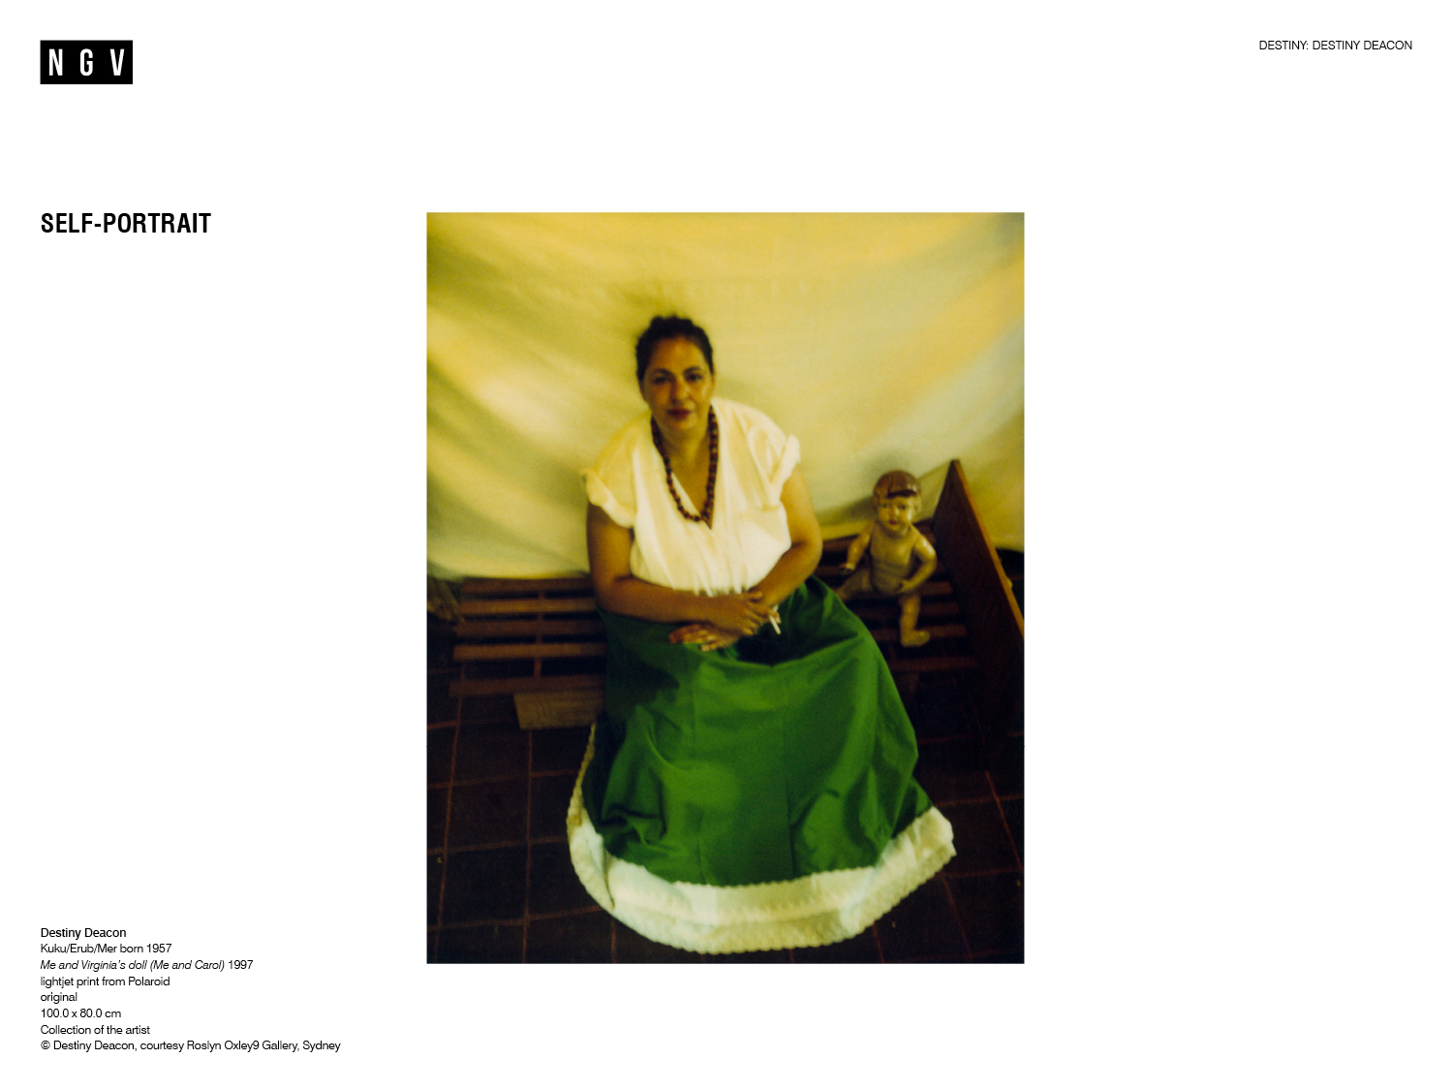
Notes:
Self-portrait
In Me and Virginia’s doll (Me and Carol), Deacon is pictured sitting beside a doll, which belongs to her long-time friend and collaborator, Virginia Fraser. Deacon presents herself as Mexican artist Frida Kahlo (1907-1954), staging the image as a homage to Kahlo’s painting Me and my doll, 1937.
Growing up in Port Melbourne, Deacon and her friends would play a game called ‘arrow chasey’. They would travel across suburbs, following chalk arrow marks on the ground in search of the mark maker and the promise of an explanation. Sometimes the marks were misleading, but eventually they would find an arrow which put them on the right track.
Understanding Deacon’s work can be difficult as she often creates a dense web of references, shifting audience perceptions through hidden messages and clues. Just like in the ‘Arrow chasey’ game, see if you can find ‘arrows’ in the artwork: the next clue might just lie in the title.
Discussion prompts
Look at the artwork on the slide. Where does your eye start and finish as it moves around the image?
How has Deacon utilised art elements and principles to direct and focus your attention on different parts of the image? Consider composition, colour, line and form.
How do these factors inform your reading of the artwork?
Describe the facial expressions of Destiny Deacon and the doll. What mood do they create?
Why has the artist chosen to include a doll in her self-portrait? What might the relationship be between them?
Research the life and work of Frida Kahlo. What parallels can you find between the two artists? Why do you think Deacon chose to create an homage to her?

Slide 4
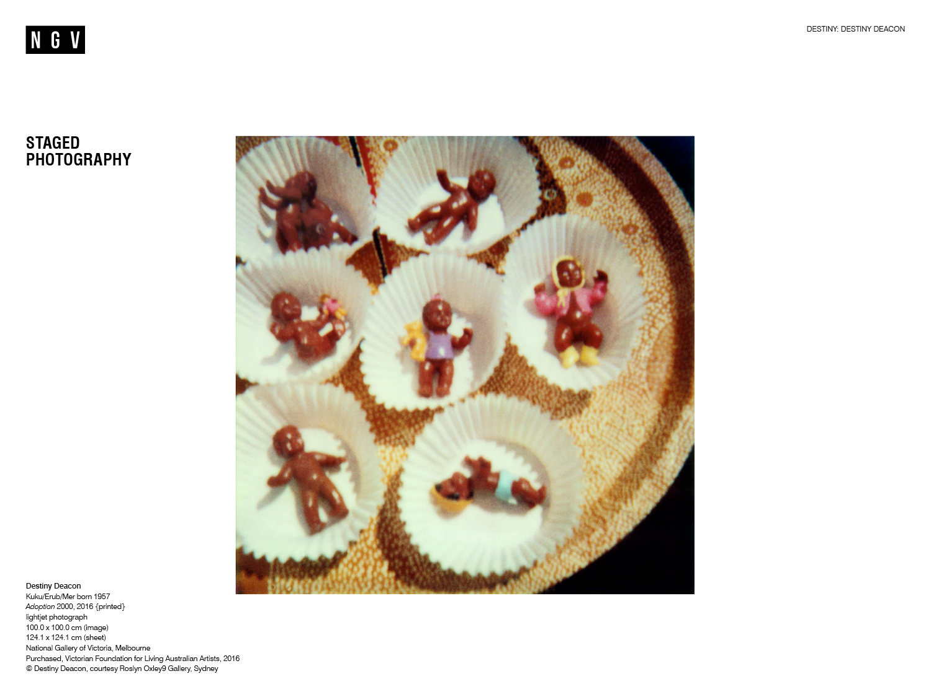
Notes:
Staged Photography
Deacon started taking photos in her 30s, taking a low-tech and personal approach to the history and politics of colonisation, exclusion and marginalisation in Australia. Initially, she processed film using a darkroom in a laundry but later began using a polaroid camera. Deacon creates her images by photographing staged installations inside her home studio. Usually these are composed made up of household items or objects from her collection of Koori Kitsch. Deacon then digitally scans the photographs and enlarges them. Lastly, she creates an inkjet/bubble or light-jet printed image as the completed work. The photographs often have a blurred focus and flat lighting, typical of the instamatic documentation of a moment.
To read about the artwork on the slide, Adoption, 2000, visit the MCA website: https://www.mca.com.au/artists-works/works/2005.11/
Discussion prompts
Look at the artwork on the slide. What do you think Deacon is trying to suggest through the image and its title?
By placing toy black babies in cupcake holders, and titling the work Adoption, what historical events might Deacon be referencing?

Slide 5
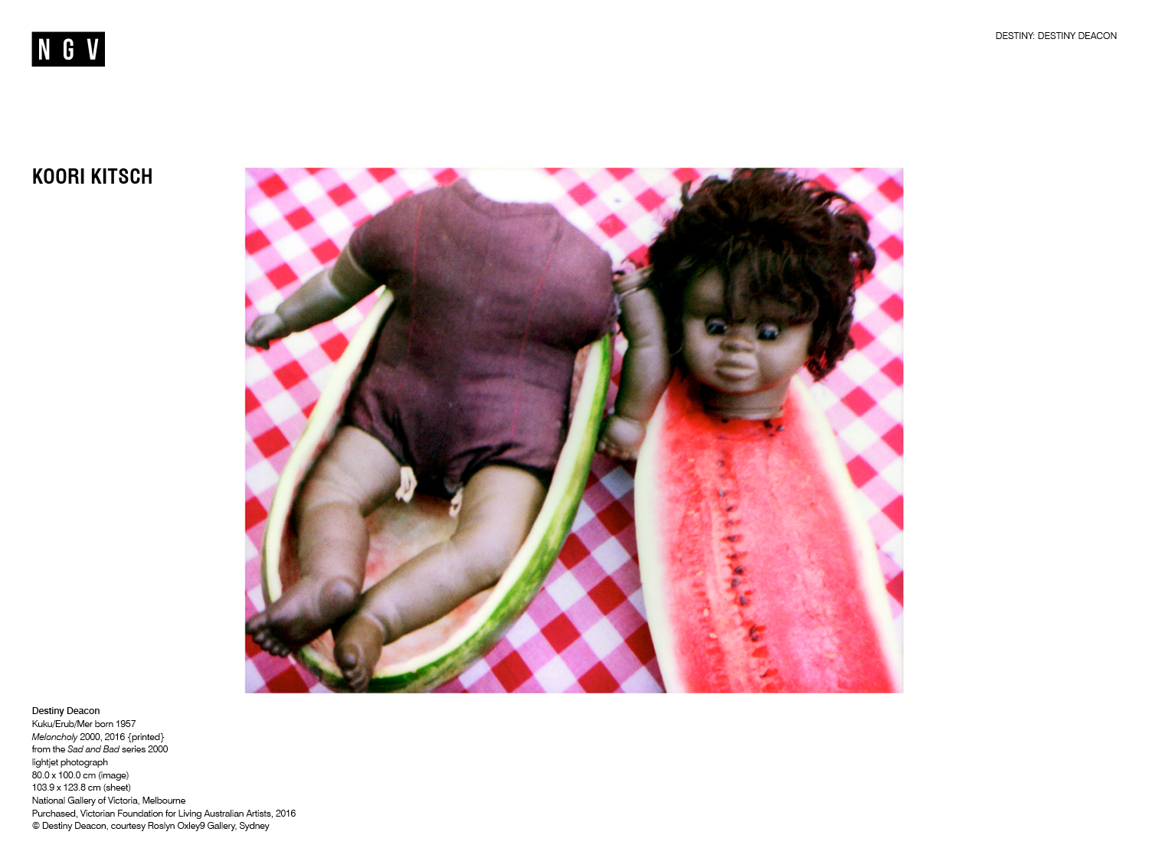
Notes:
Koori kitsch
In staged photographs Deacon often uses knick-knacks that at best portray Aboriginal people as decoration and at worst perpetuate racist stereotypes. Deacon has spent years retrieving objects like dolls, ashtrays or tea towels from second-hand stores around Australia. She calls this type of material culture Koori kitsch, and she uses it to interrogate Aboriginal identity, in particular her own.
In Meloncholy, 2000 Deacon has staged a scene by placing one of her dolls, contorted and dismembered, within a hollowed-out watermelon. The watermelon is used as a racist symbol to denigrate African Americans in the USA. The combination of Koori Kitsch, which misrepresents Australia’s indigenous people, and an American racist trope is jarring. It confronts the audience with examples of ugly stereotypes which keep racism and marginalisation alive around the world.
Discussion prompts
What do you think is happening in Melancholy? Consider the environment that Deacon has created for the doll.
Which meanings and ideas are being communicated in Melancholy? How does Deacon employ symbolism, and the art elements and principles, to communicate her message?
Of Koori kitsch, Deacon has said: ‘In the beginning I wanted to rescue them, because otherwise they’d end up in a white home or something, somewhere no-one would appreciate them.’
Why would Deacon use the word ‘rescue’?
How does the idea of ‘rescuing’ culturally appropriated items relate to colonial Australian history?

Slide 6
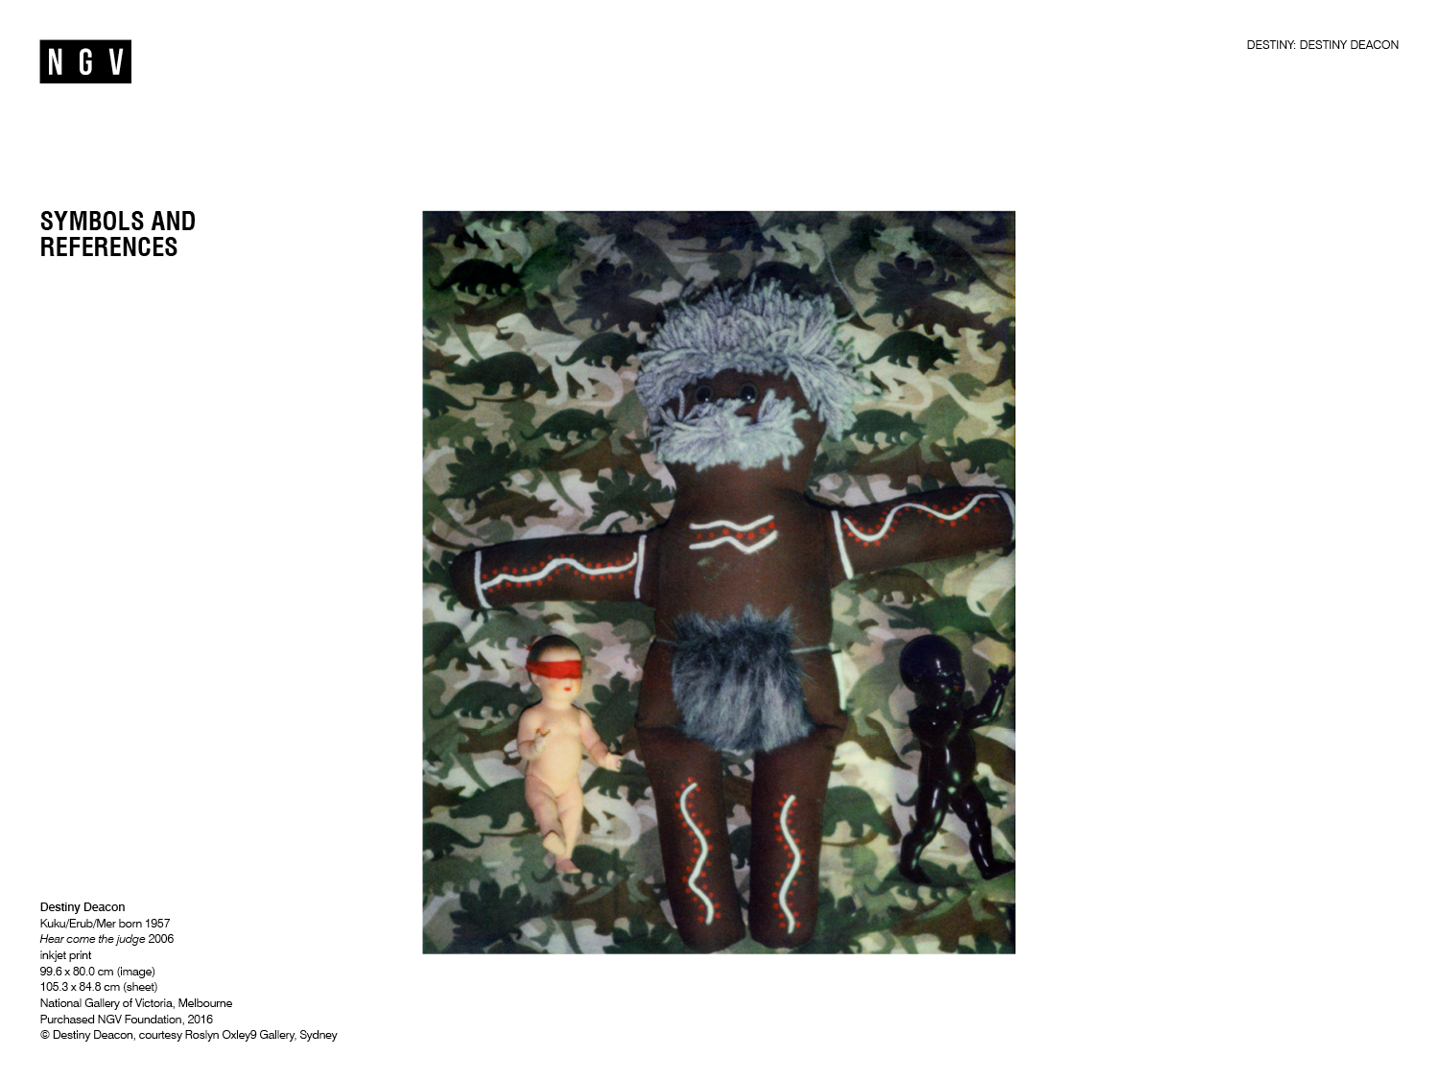
Notes:
Symbols and references
In blurring the line between the sad and the humorous, Deacon shows audiences how the truth is often absurd. One of the techniques she uses to do this is to appropriate familiar song titles, twisting them to mean something new. In her 2006 photograph Hear come the judge, Deacon references the 1968 comedy-funk track ‘Here Come the Judge’ by Dewey ‘Pigmeat’ Markham. The song that the photo is referencing is regarded by many to be the first ever recorded hip-hop track. It is a comedy routine where a courtroom has been taken over by black people, the supposed ‘joke’ is that this is ‘funny’ because it’s unlikely.
The blindfolded white doll is a reference to the notion, originating in the sixteenth century, that justice is blind, and therefore unbiased. The legal system in Australia is subject to the laws written into the Australian constitution, which does not recognise the prior occupancy of indigenous people and the laws and rights they established before British colonisation. According to the Australian Bureau of Statistics*, in 2017 Aboriginal and Torres Strait Islander people represented just over a quarter of the total prison population, despite being only approximately 2 per cent of the Australian adult population. Deacon is mocking these statistics, suggesting that justice is only blind if you’re white.
In addition to symbols of justice, religious symbols are also visible in Hear Come the Judge. The large doll’s central position and pose with outstretched arms is reminiscent of the Christian crucifixion story, while the red and white stitching on the doll references Indigenous ceremonial body paint.
Discussion prompts
Which symbols can you identify in Hear come the judge? Create a list.
What do you think they could be referring to?
What new meanings do they take on when read together? For example, consider the colour, pose and stitching on the central doll, the doona pattern, and the blindfold on the white-skinned doll.
Watch ‘Here Come the Judge’ by Dewey ‘Pigmeat’ Markham on YouTube. Why do you think Deacon chose to reference this song in the artwork title?
What do you think Deacon is trying to say about the justice system in Australia? What evidence can you find in the artwork to support your view?
*Australian Bureau of Statistics, ‘4517.20 – Prisoners in Australia, 2017’, 8 Dec. 2017, ABS, Australian Government, https://www.abs.gov.au/ausstats/abs@.nsf/Lookup/by%20Subject/4517.0~2017~Main%20Features~Prisoner%20characteristics,%20Australia~4 accessed 23 Sep. 2019.

Slide 7
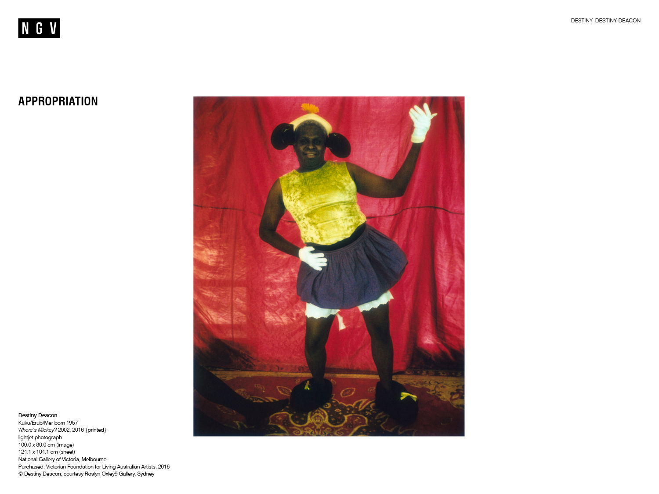
Notes:
Appropriation
Artists often use appropriation to highlight or subvert the meanings and values associated with the images or objects. In Where’s Mickey?, 2002, Deacon has photographed her friend Luke Captain, a Torres Strait Islander man, dressed as a drag version of Disney’s Mickey Mouse. Adopting the artistic strategy of appropriation, the artist has poked fun at Disney character Mickey Mouse, one of the most enduring icons of American consumer culture. Through the late 1950s, the character was leader of the Mouseketeers, a club which celebrated the image of an idealised white American child.
By casting an Aboriginal Australian Man as the famous cartoon mouse, Deacon draws attention to the exclusion of non-white people from popular entertainment and culture. The saturated red, yellow and black areas of the image represent the colours of Disney’s mouse whilst alluding to colours of the Aboriginal Australian Flag, designed by Lurijtja artist Harold Thomas in 1971. The artwork title is a play on words: in Australian vernacular the phrase ‘Mickey Mouse’ describes something substandard, poorly executed or amateurish.
Discussion prompts
Look at the title of the artwork on the slide, what clue does it give about what the work might be about?
What examples of appropriation can you find in Where’s Mickey??
Which meanings and ideas is Deacon attempting to communicate in this work? Consider the artist’s choice of model, and his clothing.
What emotions are expressed through this work and how? Consider the role of gesture, expression, body language and colour.

Slide 8
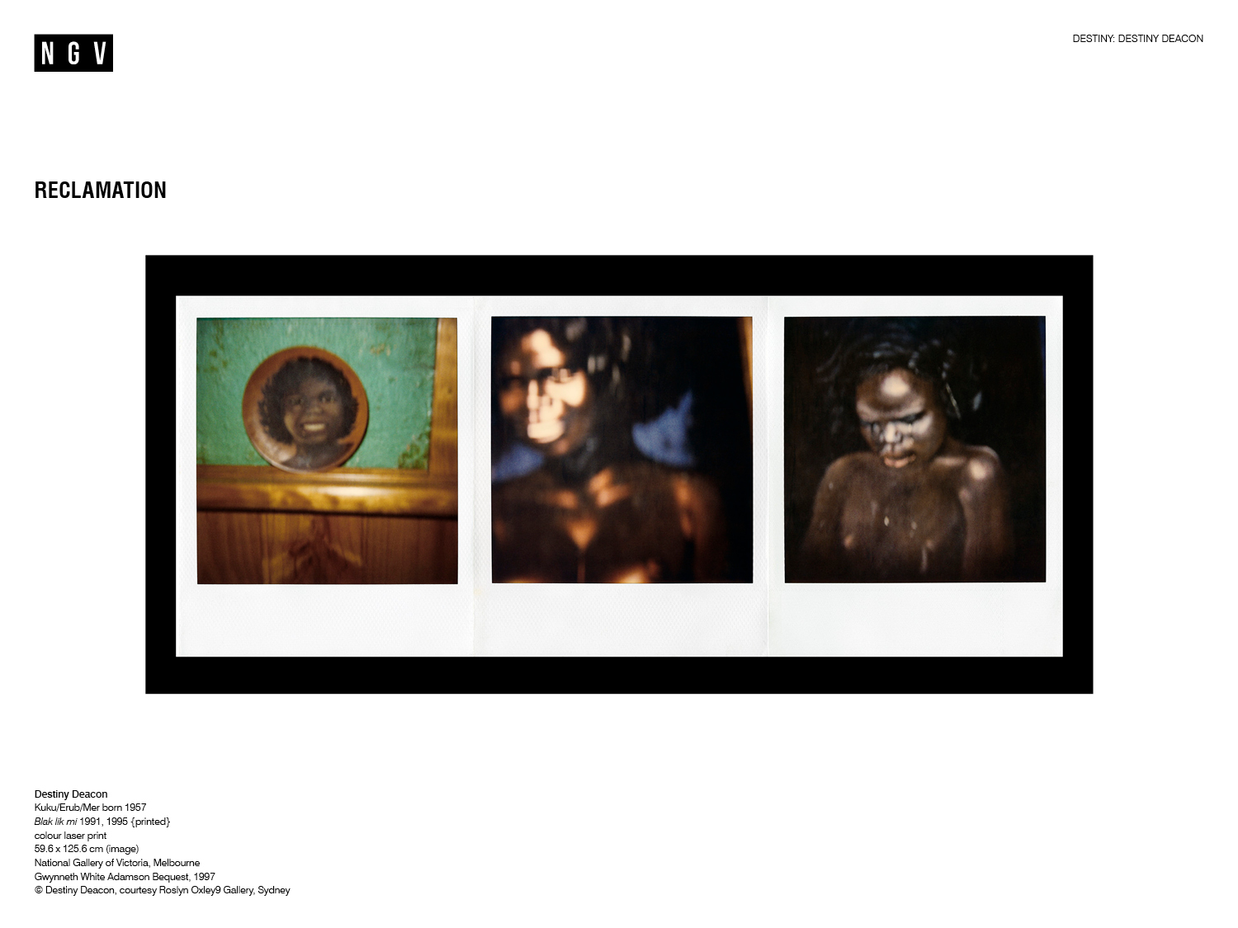
Notes:
Reclamation
In Blak lik mi, 1991, Deacon has photographed three examples of Koori kitsch. The two rightmost images are reproductions of a photograph from non-indigenous photographerAxel Poignant which originally appeared in his book Piccaninny Walkabout from 1957, which was later renamed Bush Walkabout. Poignant’s original photograph was later reproduced throughout Australia, on decorative items for the home without his knowledge.
By photographing these images once again, Deacon switches her position from subject to photographer and redefines her perceived blackness. Her work reclaims the right of Indigenous people to their own representation, rewriting the relationship between contemporary Aboriginal people and Koori kitsch.
Deacon is widely credited with introducing the word ‘Blak’ to contemporary Indigenous Australian culture. Since Blak lik mi was first displayed in the early 1990s, many Indigenous Australians prefer to identify as 'Blak'. The alternative spelling of the word is an example of reclamation through language. It gives Indigenous people the opportunity to self-identify, to reject the classifications established by colonisers and to distinguish their experience from other First Nations people and people of colour.
Discussion prompts
Create a list of words to describe the atmosphere in Blak lik mi.
What artistic choices has the artist made to create this atmosphere? Consider the use of photographic techniques (lighting, focus and cropping) or art principles (scale, hierarchy, unity and repetition).
The images on the slide were originally photographed by a non-indigenous photographer/anthropologist, before Deacon reproduced them in Blak lik mi. What effect can the identity of a photographer, and their relationship to the subject, have for the meaning of an artwork?
Reclamation means taking back rightful possession of something. How does Blak lik mi reflect the concept of reclamation? Consider the alternative spelling of ‘blak’ and photographs of reproduced imagery.

Slide 9
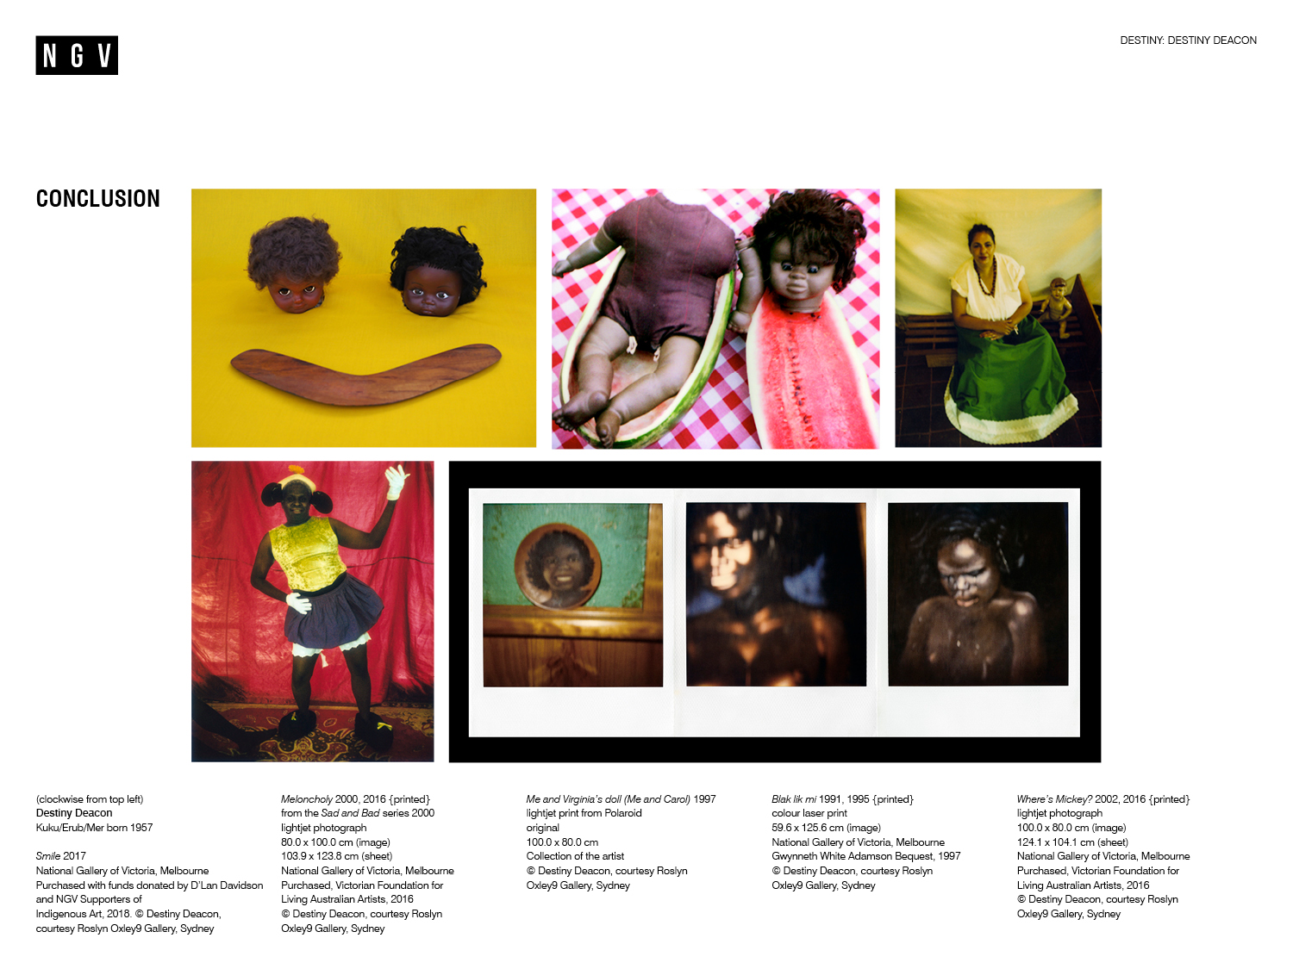
Notes:
Conclusion
Destiny Deacon has said about her photography: ‘I like to think there is a laugh and a tear in each picture’. She uses humour in her art to process and reveal the truth of her experience as an Indigenous woman in urban Australia. Her work draws the audience in, only to leave them standing at close range, confronting the uncomfortable truths of contemporary Australian society.
Reflective prompts
Review the words you initially created to describe Smile, 2017. How have your thoughts about Deacon’s art and practice changed? Discuss.
Which of Destiny Deacon’s works did you find the most interesting? Which was the most effective at conveying the artist’s message? Explain your answers.

Slide 10
