Slide 1
Notes:
Slide notes adapted from M.C. Escher: More Than Meets the Eye Printmaking (Ch 5) with thanks to Jessica Cole Curatorial Project Officer, Prints and Drawings at the National Gallery of Victoria.

Slide 2
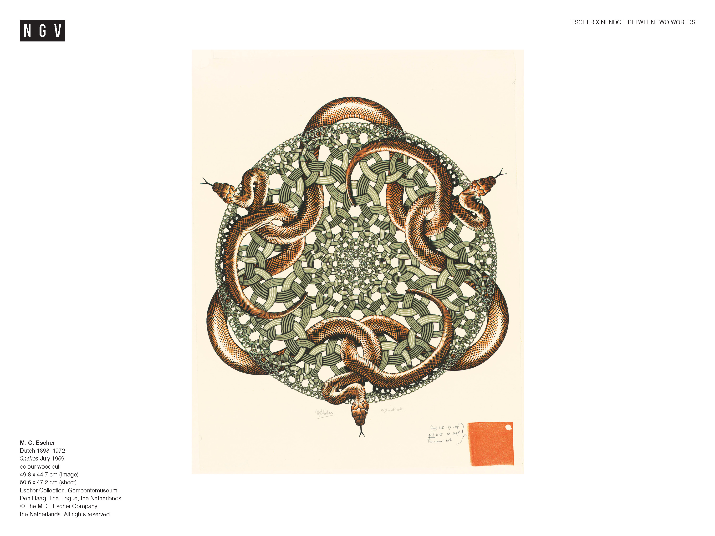
Notes:
Share this information with your students:
M.C. Escher was a graphic artist, an artist who makes images to be reproduced in multiples. He made prints – images produced by a process of transfer from one surface to another that enables multiplication.
He said: ‘I make things to be reproduced in quantity; that’s just my way.’ ¹
¹ Bruno Ernst, The Magic Mirror of M.C. Escher, Taschen, Koln, 2007, p.75.
Escher made his first print when he was seventeen, and his last (pictured here) when he was seventy-one. By the end of his life, he had made 448 prints and more than 2000 drawings and sketches.
He used a variety of printmaking techniques, each with its own processes and characteristics.

Slide 3
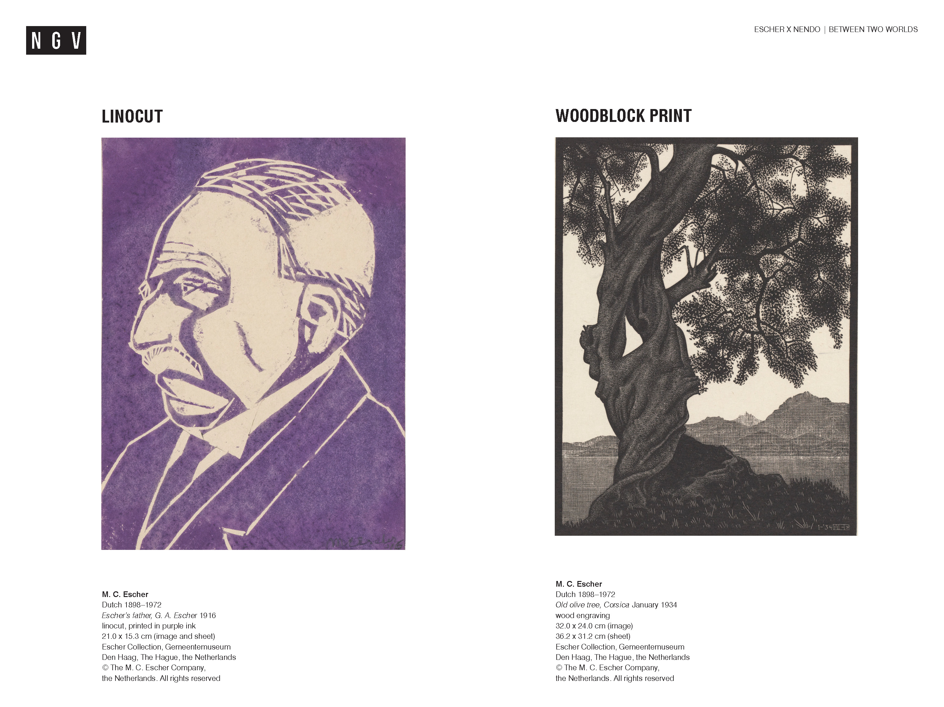
Notes:
Share this information with your students:
Escher made his first print – a linocut – when he was in high school. It was an image of his father (above). A linocut is a type of relief printing process, in which the artist carves his or her design out of a piece of linoleum or another flat surface (block). The lino surface is rolled with ink using a hand roller called a brayer. Paper is placed on the block and pressure is applied to the paper to transfer the ink from the block to the paper. The parts that are not cut away are printed. Rather than a mechanical printing press, Escher used the back of a small bone spoon to print his image, or a rolling pin for larger works.
When he attended the School of Architecture and Decorative Arts in Haarlem, Escher’s teacher Samuel Jessurun de Mesquita, introduced him to woodcuts. Woodcuts or woodblock prints became his preferred medium.
For some of his more complicated woodcuts, Escher used a number of blocks to create the final printed image. The image Snakes, 1969 on the previous slide was Escher’s last print. It was printed using three colours, from three wedge shaped woodblocks printed three times each to complete the image. To do the detailed carving, Escher used a strong magnifying glass, with a light.
Ask students:
How are tonal effects achieved in a wood block or linocut? To achieve a tonal range varying degrees of the block must be cut away to balance dark and light.

Slide 4
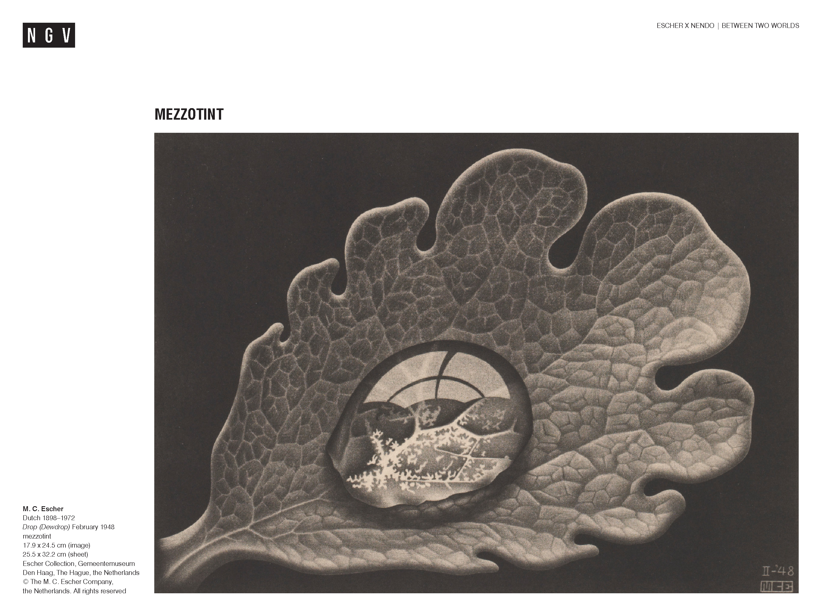
Notes:
Share this information with your students:
This image is an example of a mezzotint. Mezzotint is a method of intaglio printing, which is basically the opposite of relief printing. Instead of cutting away the parts of the image you don’t want to print, the image itself is incised into a metal plate with either a sharp tool or acid (which ‘bites’ away the metal).These incised lines and sunken areas hold the ink and create the image when printed.
Mezzotint can achieve an infinite range of tones, which was much to Escher’s liking. Rather than using acid to bite away the lines on the plate, as in etching, in mezzotint the entire surface is indented and made rough with a toothed metal rocker. When inked, the roughened surface prints as a rich black. Once the plate is roughened, burnishers and scrapers are then used to smooth the areas that will form the lighter parts of the image. The smoother the area, the less ink it will hold and the closer it gets to white. Using this method, Escher could create subtle gradations in tone. In order to track his progress while making his mezzotints, Escher printed the plate in different stages, called states. The downside of mezzotint is that running the plate through the press flattens the rough surface, making the print lighter and less crisp with each impression. This limits the number of prints that can be made from each plate. Preparing a mezzotint plate is also a very laborious process. Perhaps for this reason, Escher only made eight mezzotints – although they are among his most impressive prints.

Slide 5
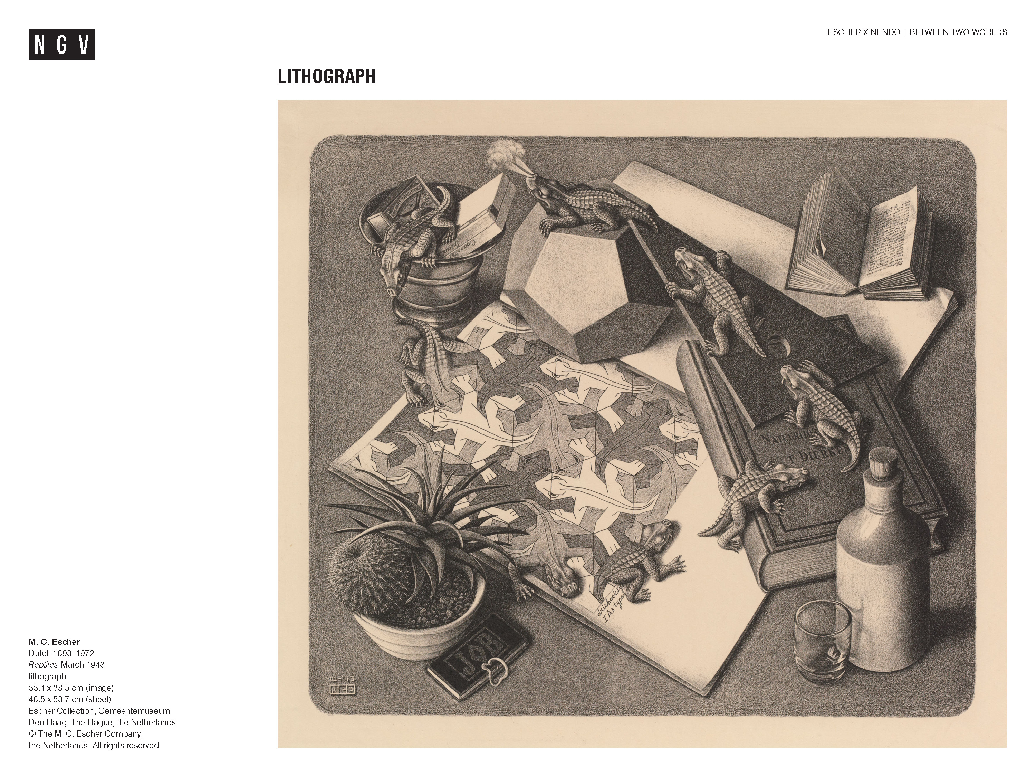
Notes:
Share this information with your students:
Lithography
Escher was a big fan of lithography because it is the closest printmaking technique to drawing with a pencil. In fact, it is drawing with a pencil. In lithography, the artist draws with an oil-based pencil onto a thick, smooth block of limestone (líthos is a Greek word for stone). The surface of the stone is then dampened with water, which is repelled by the oil pencil and rests only
in the unmarked areas. Next, a roller with greasy printing ink on it is rolled over the surface, which sticks only to the greasy drawn areas, not the wet parts. In the final part of the process, the ink is transferred to a sheet of paper by running the paper and stone surface together through a press. Lithography was the only print technique that Escher couldn’t do himself. After he had finished the drawing on the stone, he hired a specialist lithography printer to do the rest.
Because the tool used to make the print is just a pencil, not a metal knife or scraper, in his lithographs Escher could create lots of shading, such as in Reptiles, March 1943. Only ten litho stones were found in Escher’s studio at the time of his death, but he made more than seventy lithographs in his lifetime. This is because in lithography, the same stone can be used again and again for different prints. Once Escher had finished a work, he would wipe the stone clean and sand it down to smooth the surface in preparation for a new drawing.
After Escher died, his stones, mezzotint plates and wood blocks were all cancelled (damaged in some way), as per his instructions. Any posthumous print would then contain a defect, indicating that it was not printed or supervised by Escher.

Slide 6
Notes:
Share this information with your students:
Escher completed many drawings and studies before he was ready to make a print of an image. He described drawing as ‘an indispensable link in the chain of his activities, but [as a graphic artist], never his goal.^{’3}
³ M.C. Escher, Escher on Escher, Harry N. Abrams, 1986, p.13.
Some of Escher’s studies are pictured here. Despite his protestations that he couldn’t draw – ‘I am absolutely incapable of drawing.’ (Bruno Ernst, The Magic Mirror of M.C. Escher, p.72), he was a skillful draughtsman and a meticulous craftsman. He printed all of his own work, with the exception of his lithographs, which he signed and numbered. He often annotated his prints ‘eigen druk’ which meant printed with his own hand. Every print was made in a limited edition.
There is tremendous satisfaction to be derived from the acquisition of artistic skill and the achievement of a thorough understanding of the properties of the material to hand, and in learning with true purposefulness and control to use the tools which one has available – above all, one’s own hands!
M. C. Escher, 1959
⁴ quoted in M.C. Escher, The Graphic Work, M.C. Escher, TASCHEN, Koln, 2007, p.6.

